Slide 1
Lecture 4
Problem Decomposition

Slide 2
Review

Slide 3
Solutions 1
public
static int
getMinIndex(int[] values) {
int minValue
int minIndex
= Integer.MAX_VALUE;
= -1;
for(int i=0;
i<values.length; i++)
if | (values[i] | < | minValue) {
 | minValue | = | values[i];
 | minIndex | = | i;
}
return
minIndex;
}

Slide 4
Solutions 2
public
static int
getSecondMinIndex(int[]
values) {
int secondIdx
int
= -1;
minIdx=
getMinIndex(values);
for(int i=0; i<values.length;
if (i == minIdx)
i++) {
continue;
if secondIdx values[i]
== -1 ||
< values[secondIdx])
secondIdx = i;
}
return secondIdx;
}

Slide 5
Popular Issues 1
Array Index vs Array Value
int[] values = {99, 100, 101}; System.out.println(values[0] );
// 99
Values
Indexes
99 | 100 | 101
0 1 2

Slide 6
Popular Issues 2
Curly braces { … } after if/else, for/while
for (int i = 0; i < 5;
i++)
System.out.println(“Hi”); System.out.println(“Bye”);
What does this print?

Slide 7
Popular Issues 3
Variable initialization
int getMinValue(int[] vals) {
int min = 0; for (int i = if (vals[i]
min =
0; i <
< min)
vals.length; i++) {
{
vals[i]
}
}
}
What if vals
= {1,2,3}?
Problem?
Set min
= Integer.MAX_VALUE or vals[0]

Slide 8
Popular Issues 4
Variable Initialization – secondMinIndex
int minIdx = getMin(vals)
int secondIdx = 0;
for
(int i = 0; i <
vals.length; i++) {
continue;
if (i == minIdx)
if (vals[i] <
vals[secondIdx])
secondIdx = i;
}
What if vals = {0, 1, 2}?
See solutions

Slide 9
Popular Issues 5
Defining a method inside a method
public
static
void
main(String[]
arguments) {
{
public static
}
void foobar ()
}

Slide 10
Debugging Notes 1
Use System.out.println throughout your code
to see what it’s doing
for ( int
if
i=0; i<
vals.length;
i++) {
( vals[i] < minVal) { System.out.println(“cur System.out.println(“new minVal = vals[i];
min:
min:
” + minVal);
” + vals[i]);
}
}

Slide 11
Debugging Notes 2
Formatting
Ctrl-shift-f is your friend
for (int i = 0;
if (vals[i] minIdx=i;}
i < vals.length;
< vals[minIdx]) {
i++) {
return minIdx;}
Is there a bug? Who knows! Hard to read

Slide 12
Debugging Notes 3
// starts a comment through the end of the line
/* starts a comment that can span multiple lines
Still in the comment ….
Yet more ….
Then use the following to end the comment region */

Slide 13
Problem Decomposition
How to break the problem into simple pieces you can program?
Two basic parts:
Data structures e.g. what’s the best way to store the data
What are the actions?
What equations are useful?
What’s the logic?
Are there output specifications?
What methods are useful building blocks?

Slide 14
The Bunco Dice game
Rules (simplified):
There are six rounds, progressing in order from one to six, where the number of the round serves as the target for that round's rolls.
Within a round, players alternate turns rolling three dice, aiming to obtain the target number. A players turn is over when their roll score is 0.
Players gain one point for each die matching the target.
If the player gets three-of-a-kind of the target number (a Bunco), they get 21 points. Three-of-a-kind NOT the target, is worth 5 points.
The round stops when a player’s score is over 21 points.
The highest score at the end wins.

Slide 15
What’s a Good Process?
Be sure you understand the problem statement! Experiment if you can. If something is ambiguous, ask or make assumptions that you document.
What data should we save and in what format?
Can you write “pigeon” code that captures the main idea? Flow charts are OK too. Limit yourself to no more than ~10 lines.
In the top-level ~10 lines, likely you said high level things like: sort the list, or find the fastest, or roll the dice, etc.
For each of the high level operations, write another ~10 lines describing how that logic works.
Repeat step 5, for each high level operation, until you can see how it would be implemented in Java.

Slide 16
Example: Bunco Data
# of players (fancy if you get their name too)
Score for each player for each round
Round # => target dice value
Which player is currently active

Slide 17
Example: Bunco Top Level Pigeon Code
Enter how many players
Initialize data structures
Play all 6 rounds
Play each round until some rolls a bunco
Let each player have a turn
Score the turn

Slide 18
Example: Fibonacci sequence
Invented in the 13th century, by the Italian mathematician Leonardo Fibonacci—as a way to explain the geometric growth of a population of rabbits. He devised a mathematical sequence that now bears his name. The first two terms in this sequence, Fib(0) and Fib(1), are 0 and 1, and every subsequent term is the sum of the preceding two.
First few terms are: 0, 1, 1, 2, 3, 5, 8, 13, …
Calculate all the terms less than 10,000 the last number in the sequence will be 6765.

Slide 19
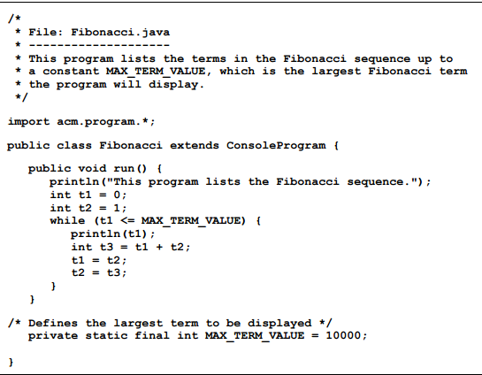
Fibonacci Solution

Slide 20
Math Puzzle
Douglas Hofstadter’s Pulitzer-prize-winning book Gödel, Escher, Bach contains many interesting mathematical puzzles, many of which can be expressed in the form of computer programs. In Chapter XII, Hofstadter mentions a wonderful problem: Pick some positive integer and call it n. If n is even, divide it by two. If n is odd, multiply it by three and add one. Continue this process until n is equal to one.
Example output:
5 is odd, so I make 3n+1: 16
16 is even, so I take half: 8
8 is even, so I take half: 4
4 is even, so I take half: 2
2 is even, so I take half: 1
The process took 5 steps to reach 1

Slide 21
Homework:
Write pigeon code for a complete Bunco game
Modify the Marathon code as described.

Slide 22
Homework: (continued)
Modify the Marathon code as follows:
Make a new method (DisplayList) that displays the list of runners and times and replace similar code in main.
Make a new method (BubbleSort) that sorts the times AND keeps the runners names matched
Method, BubbleSort, must call another method (Swap) which swaps two consecutive times and the corresponding names.
Method main outline:
Initialize names and times arrays
DisplayList // display the array as initialized
Swap //swap the 0th and 1st elements of the array
DisplayList // verify the swap worked properly
BubbleSort // sort the runners/times list by time
DisplayList // display the sorted times with runners names

Slide 23
Homework (continued)
BubbleSort Algorithm:
“Repeatedly steps through the list to be sorted, compares each pair of adjacent items and swaps them if they are in the wrong order. The pass through the list is repeated until no swaps are needed..” Wikipedia

